Slide 1
Full Stack Web Development
MongoDB / Getting Started

Slide 2
What Is MongoDB?
An open source, document-oriented NoSQL database designed with both scalability and the developer in mind
Instead of storing data in tables and rows, we store them in JSON-like documents
Uses a combination of the GNU AGPL and Apache license

Slide 3
Some Benefits Of MongoDB
Schema less – One collection holds different documents with unlimited fields of any type
Structure of a single object is clear
No complex joins
Deeper query ability
Easy to scale out

Slide 4
Documents & Collections
MongoDB is built on an architecture of collections and documents
Documents compromise sets of key/value pairs and the basic unit of data in MongoDB
Collections contain sets of documents and are similar to tables in a RDBMS

Slide 5
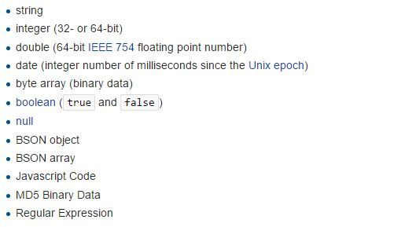
BSON
A binary representation of JSON representing simple data structures, associative arrays and various data types of specific interest to MongoDB

Slide 6
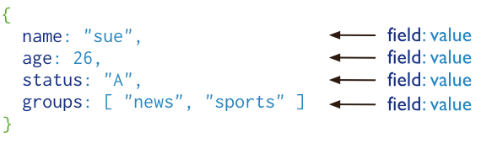
Document Example

Slide 7
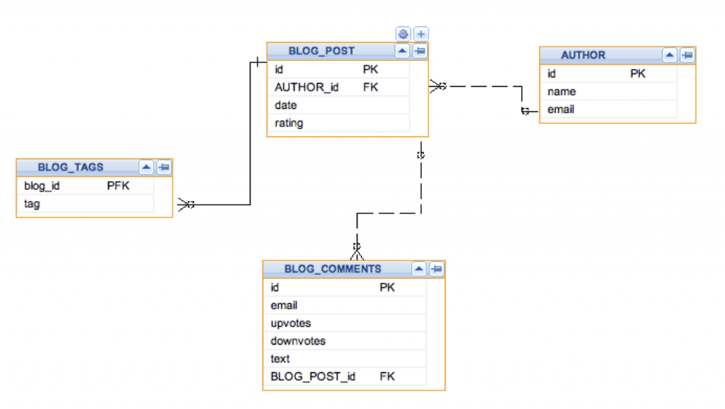
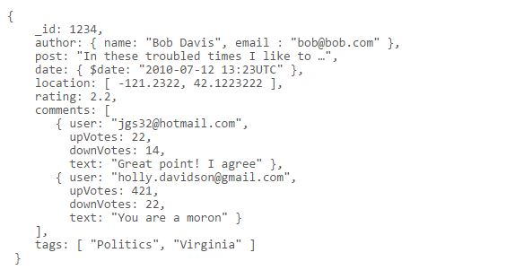
Data Structure Comparison
Relational Tables
Document

Slide 8


